Slide 1
What is Scripting?
A scripting or script language is a programming language for a special run-time environment that automates the execution of tasks; the tasks could alternatively be executed one-by-one by a human operator.

Slide 2
Script execution
In a highly simplistic view, a bash script is nothing else just a text file containing instructions to be executed in order from top to bottom.

Slide 3
Two simple ways
bash + file name
./file name

Slide 4
Variables
Variables allow a programmer to store data, alter and reuse them throughout the script.
greeting="Welcome"
user=$(whoami)

Slide 5
Comments
May the comments be with your script!
# your pretty first beatiful comment!

Slide 6
Functions
function whatIsFunction {
echo „Functions allow a programmer to organize and reuse code, hence increasing the efficiency, execution speed as well as readability of the entire script.”
}

Slide 7
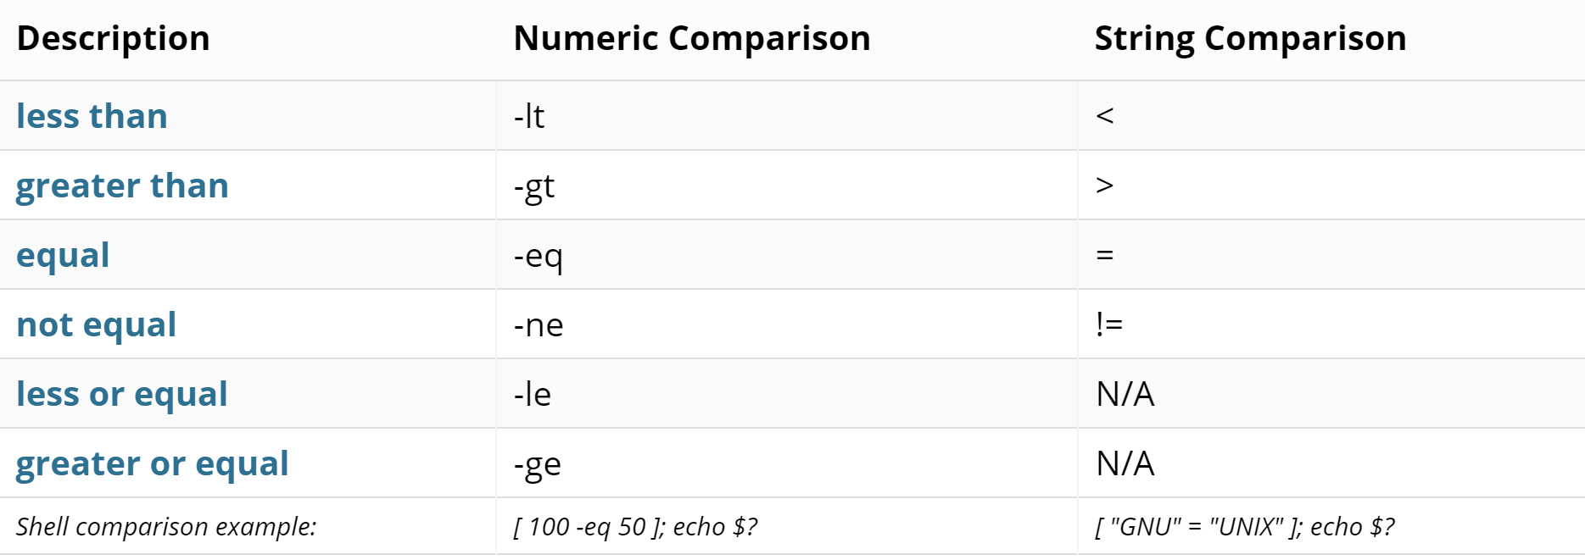
Numeric and String Comparisons

Slide 8

0, 1... WTF?!

Slide 9
Numeric and String Comparisons

Slide 10
Conditional Statement
Conditionals allow the programmer to implement decision making within a shell script based on certain conditions or events.
The conditionals we are referring to are of course, if, then and else.

Slide 11


Most popular git commands

Slide 12
Started project and than... what?

Slide 13
Create local git repository

Slide 14
Create local git repository
Navigate to your project directory and enter „git init”

Slide 15

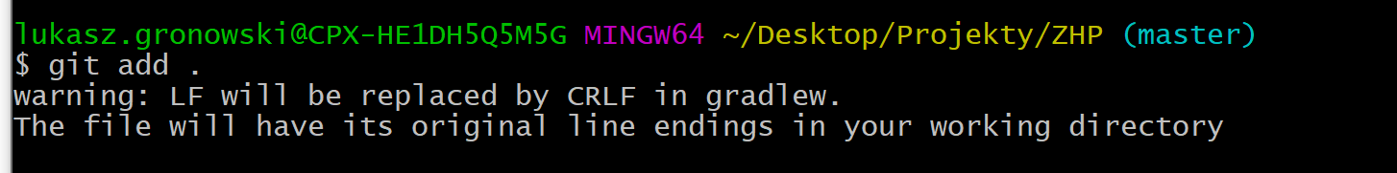
Initial commit
Remember to add edited files to commit using git add <file> or (IF YOU ARE SURE!)

Slide 16

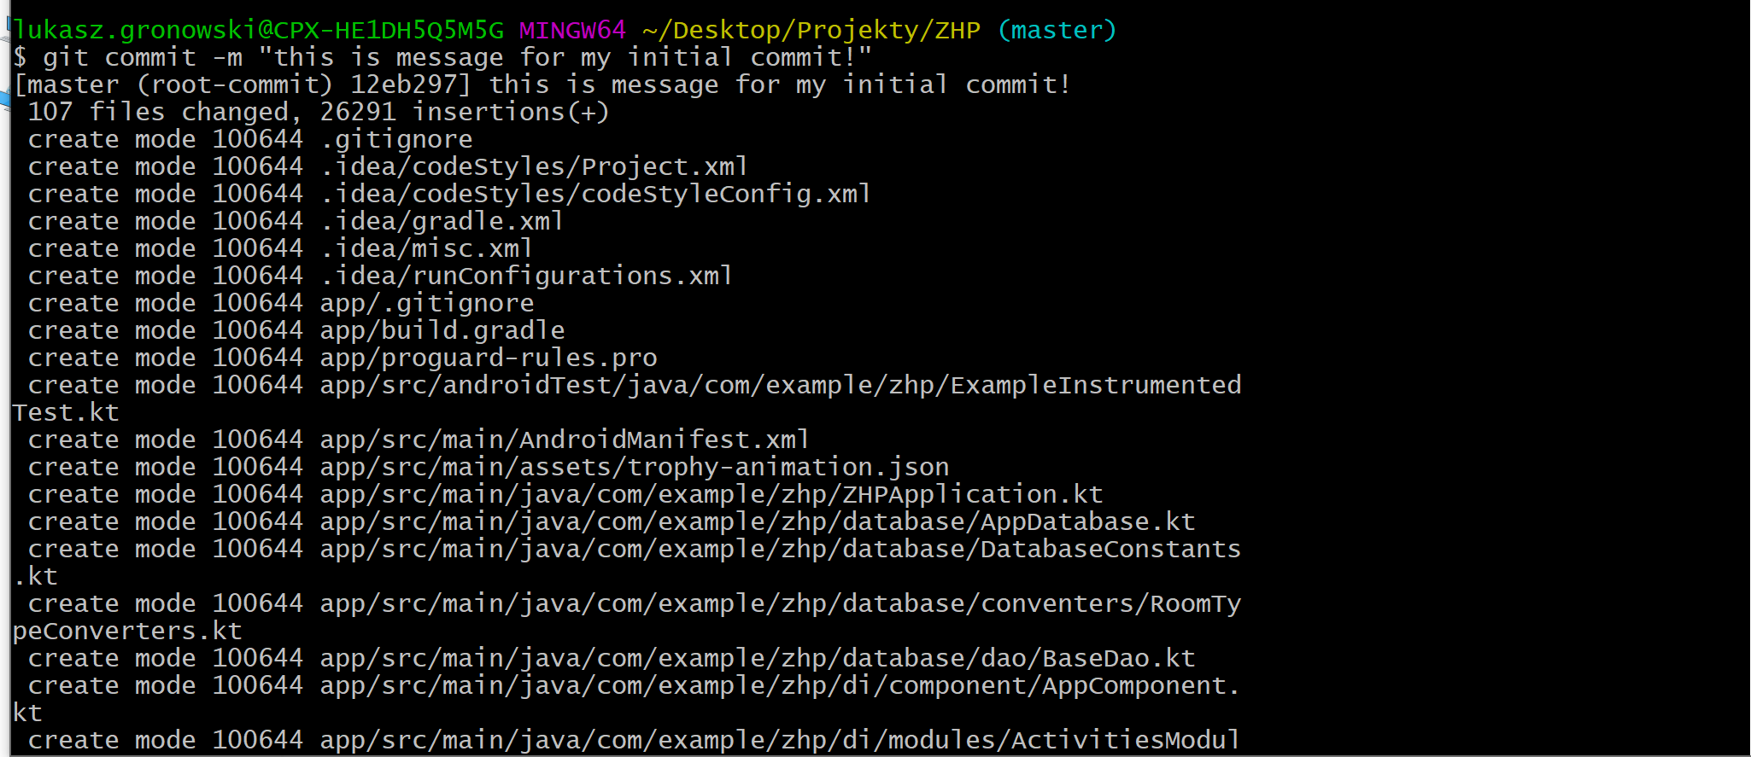
Initial commit
To create commit use git commit. If you want include message to your commit check the sequence on the left ☺

Slide 17
ALWAYS HAVE A BACKUP!!!

Slide 18
GIT REMOTE

Slide 19

If you already created git repository remotelly use „git remote add origin \ link to your repo” in your local git project directory

Slide 20
READY....

Slide 21
STADY...

Slide 22
PUSH!!!

Slide 23
Use git push to update your remote repository by local changes

Slide 24

Hmmm, what I already pushed?!

Slide 25
GIT STATUS

Slide 26


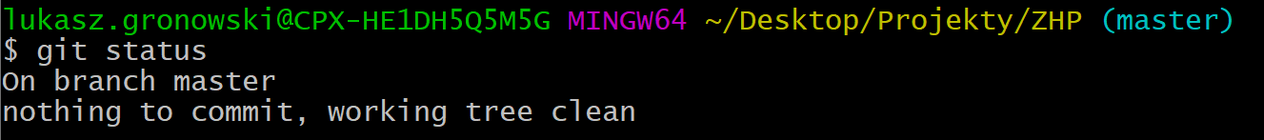
Hmmm, probably everything is what I wanted to, cause I see that:

Slide 27

Ok, after a very long time... I have a friend! (and it’s not Siri XD). Yay, now we can start to work together!

Slide 28

NEVER DO THAT:/

Slide 29
The master branch of your git repository should always contain working and stable code. However, you may want to also back up some code that you are currently working on, but isn’t entirely stable. Maybe you’re adding a new feature, you’re experimenting and breaking the code a lot, but you still want to keep a back up to save your progress! Branching allows you to work on a separate copy of your code without affecting the master branch. When you first create a branch, a complete clone of your master branch is created under a new name.
Use branches!

Slide 30

Create new branch using git checkout –b „your_branch_name” and then commit your changes. The cool idea is creating one branch per one feature of your application

Slide 31
If you want to switch to another branch use git checkout branch_what_you_want_to_switch
Switching between branches

Slide 32

Too much branches! Time to clean that mess up!

Slide 33
Git branch –d vs git branch -D

Slide 34
Wait. What? WHAT THE MERGE MEANS?!
Once you’re done adding the new feature to your branch, you’ll want to merge it back into the master branch, so that your master has all of the latest code features. To do that checkout to the master branch and use command:
git merge your_branch

Slide 35

Git blame
Use git blame filename to see who wrote that file.

